Slide 1



GEG MIS Expansion to include EmpowerU, PROSPECTS and G4DU
May, 2024

Slide 2

Requirements
1
Pre-Registration
Separation of beneficiary name
2
Registration
Unique beneficiary Identity
Register beneficiary in NSR
School status and back to school
Secondary school transition status
Skill and business details
Disability status
Vulnerability status
Exit status
3
Mentoring
Easy navigation in data entry
4
Grievance
Assign grievance to specific user
Quick access to open grievance
5
Cash Transfer
Creation of email alerts
6
Generate Report
Generation of reports and statistics

Slide 3

BR 1 Separation of beneficiary name beneficiary names

Slide 4
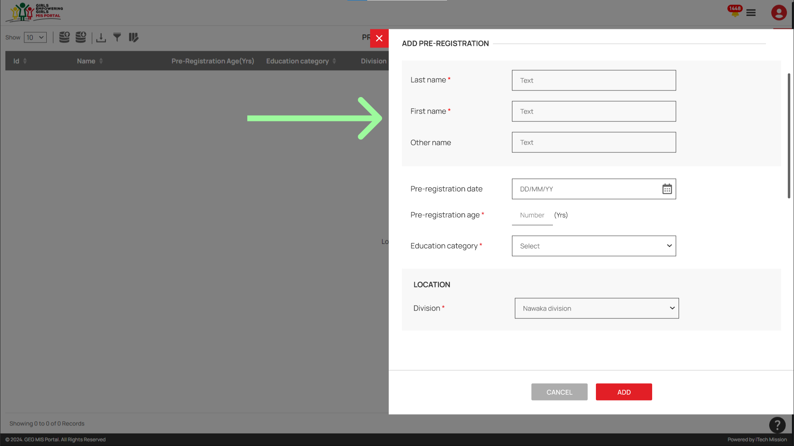
BR 1 Separation of beneficiary name beneficiary names

Slide 5
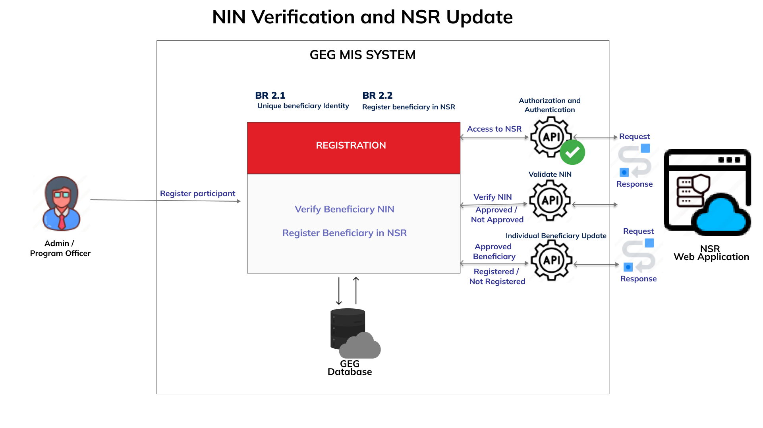
BR 2.1 Unique beneficiary Identity

Slide 6
BR 2.2 Register beneficiary in NSR

Slide 7
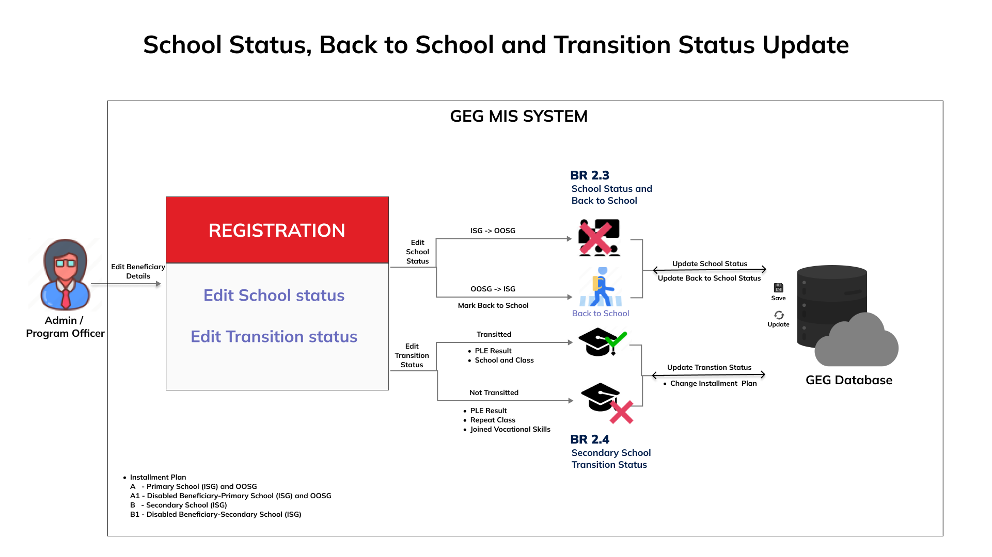
BR 2.3 School status and back to school

Slide 8
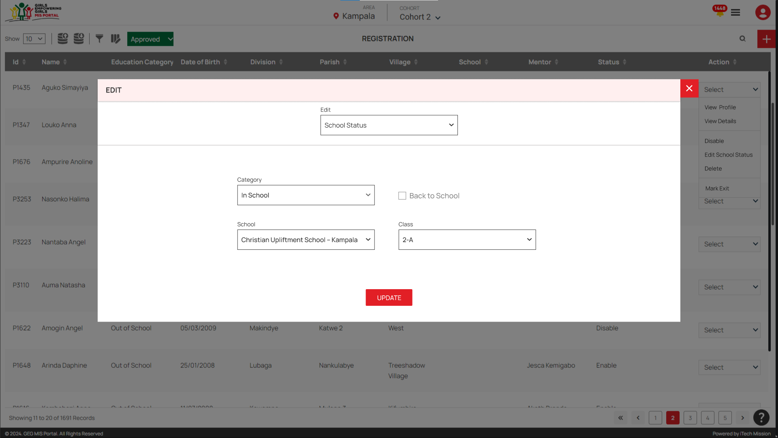
BR 2.3 School status and back to school

Slide 9
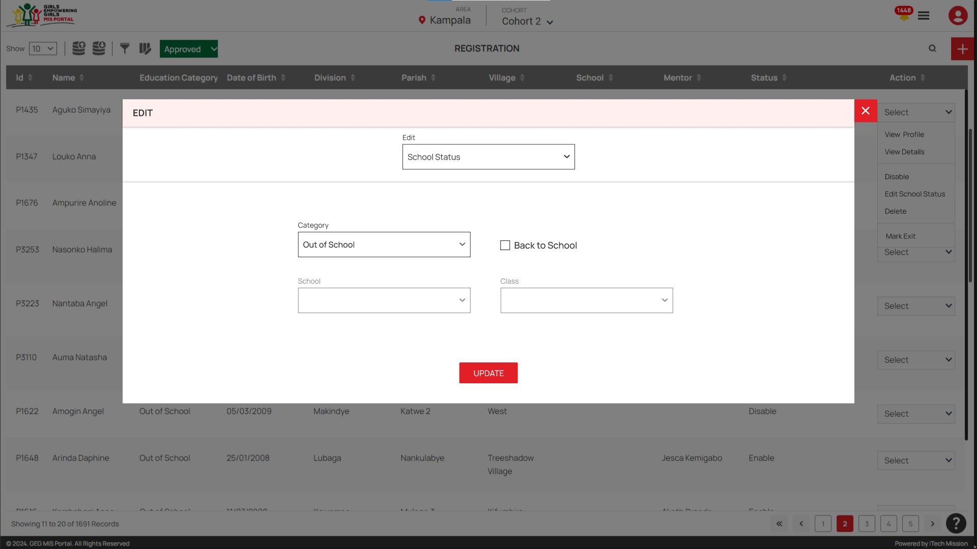
BR 2.3 School status and back to school

Slide 10

BR 2.3 School status and back to school

Slide 11
BR 2.4 Secondary school transition status

Slide 12
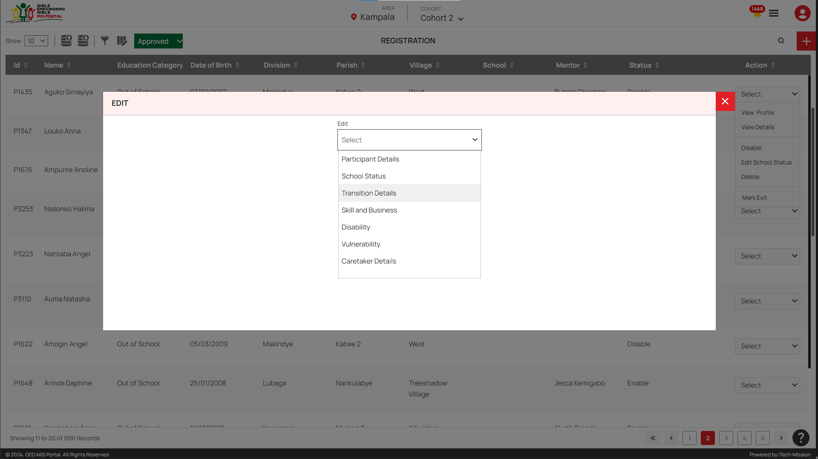
BR 2.4 Secondary school transition status

Slide 13
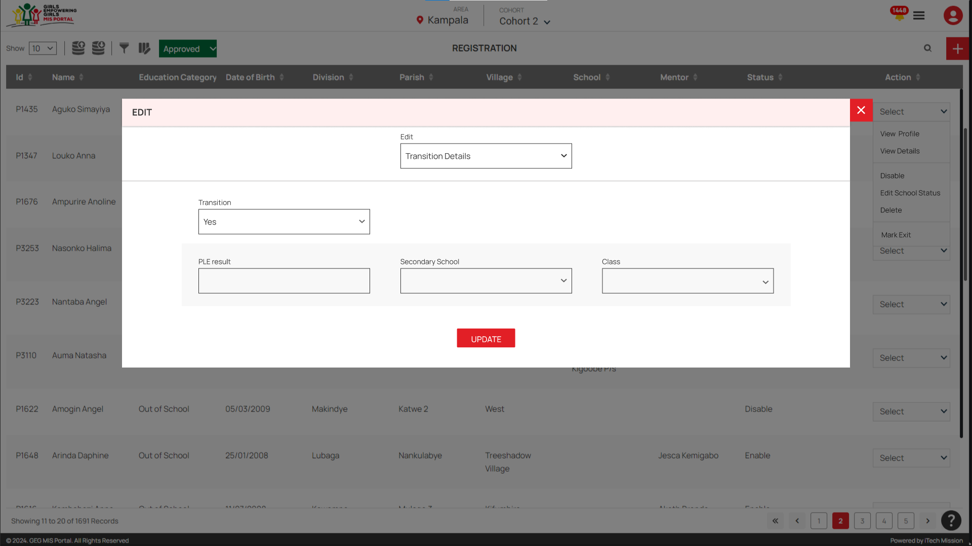
BR 2.4 Secondary school transition status

Slide 14
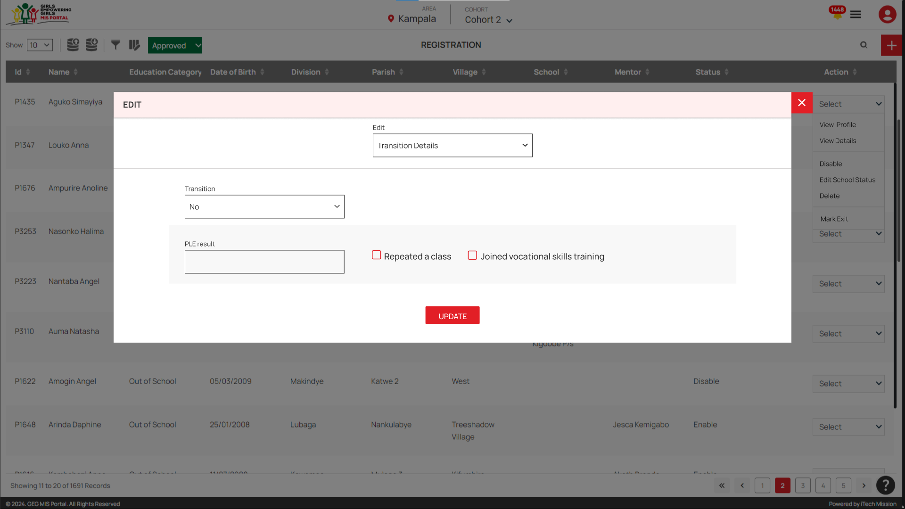
BR 2.4 Secondary school transition status

Slide 15
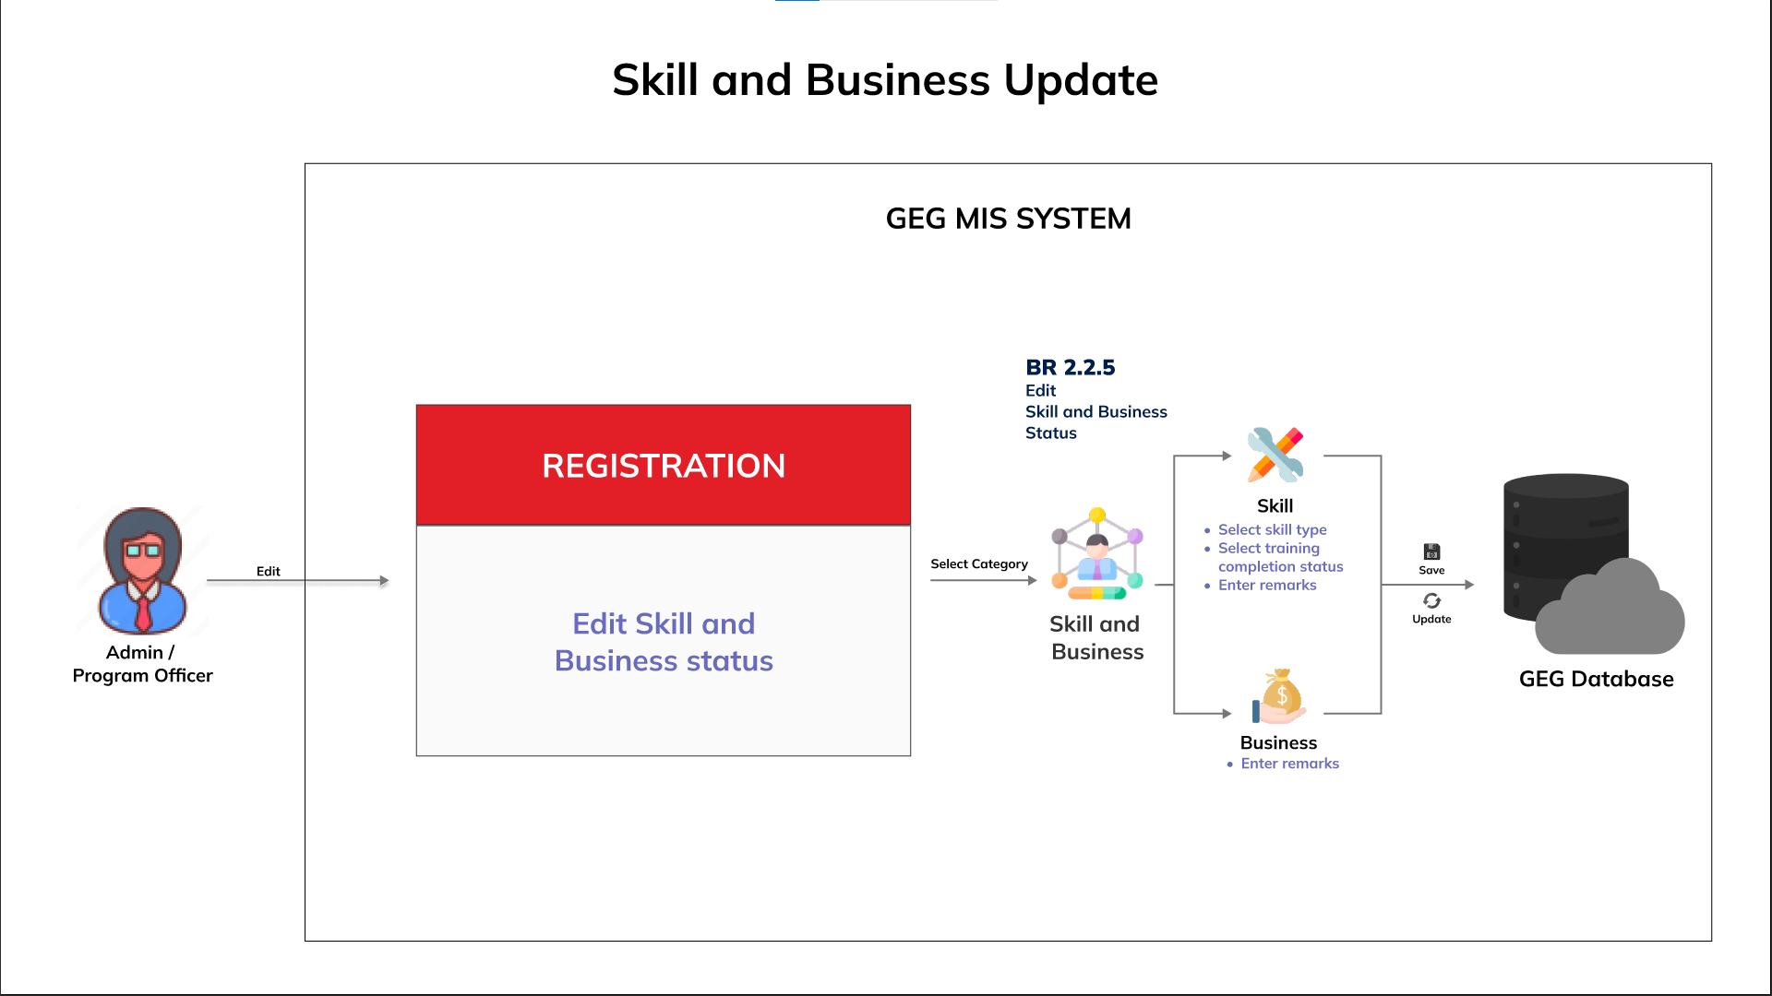
BR 2.5 Skill and business details

Slide 16
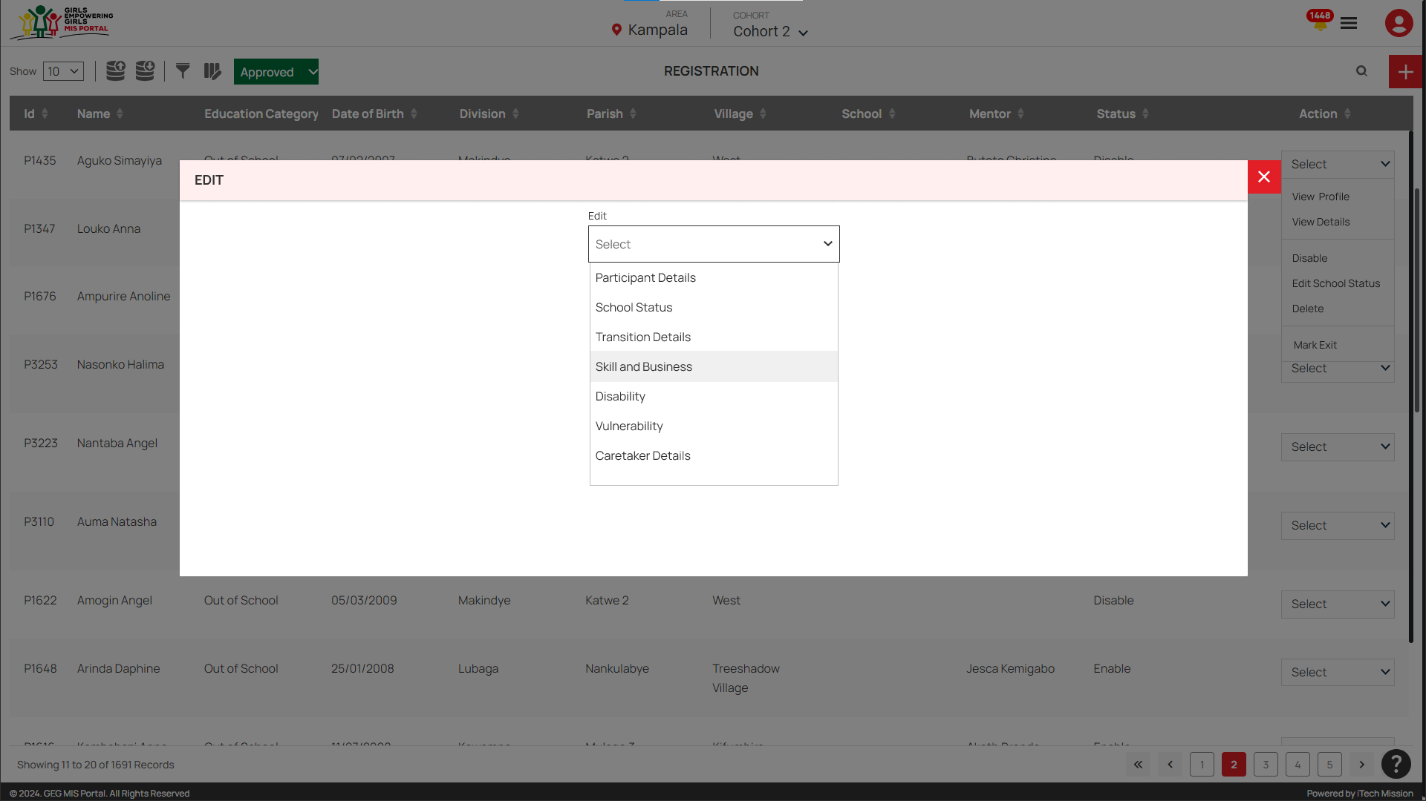
BR 2.5 Skill and business details

Slide 17
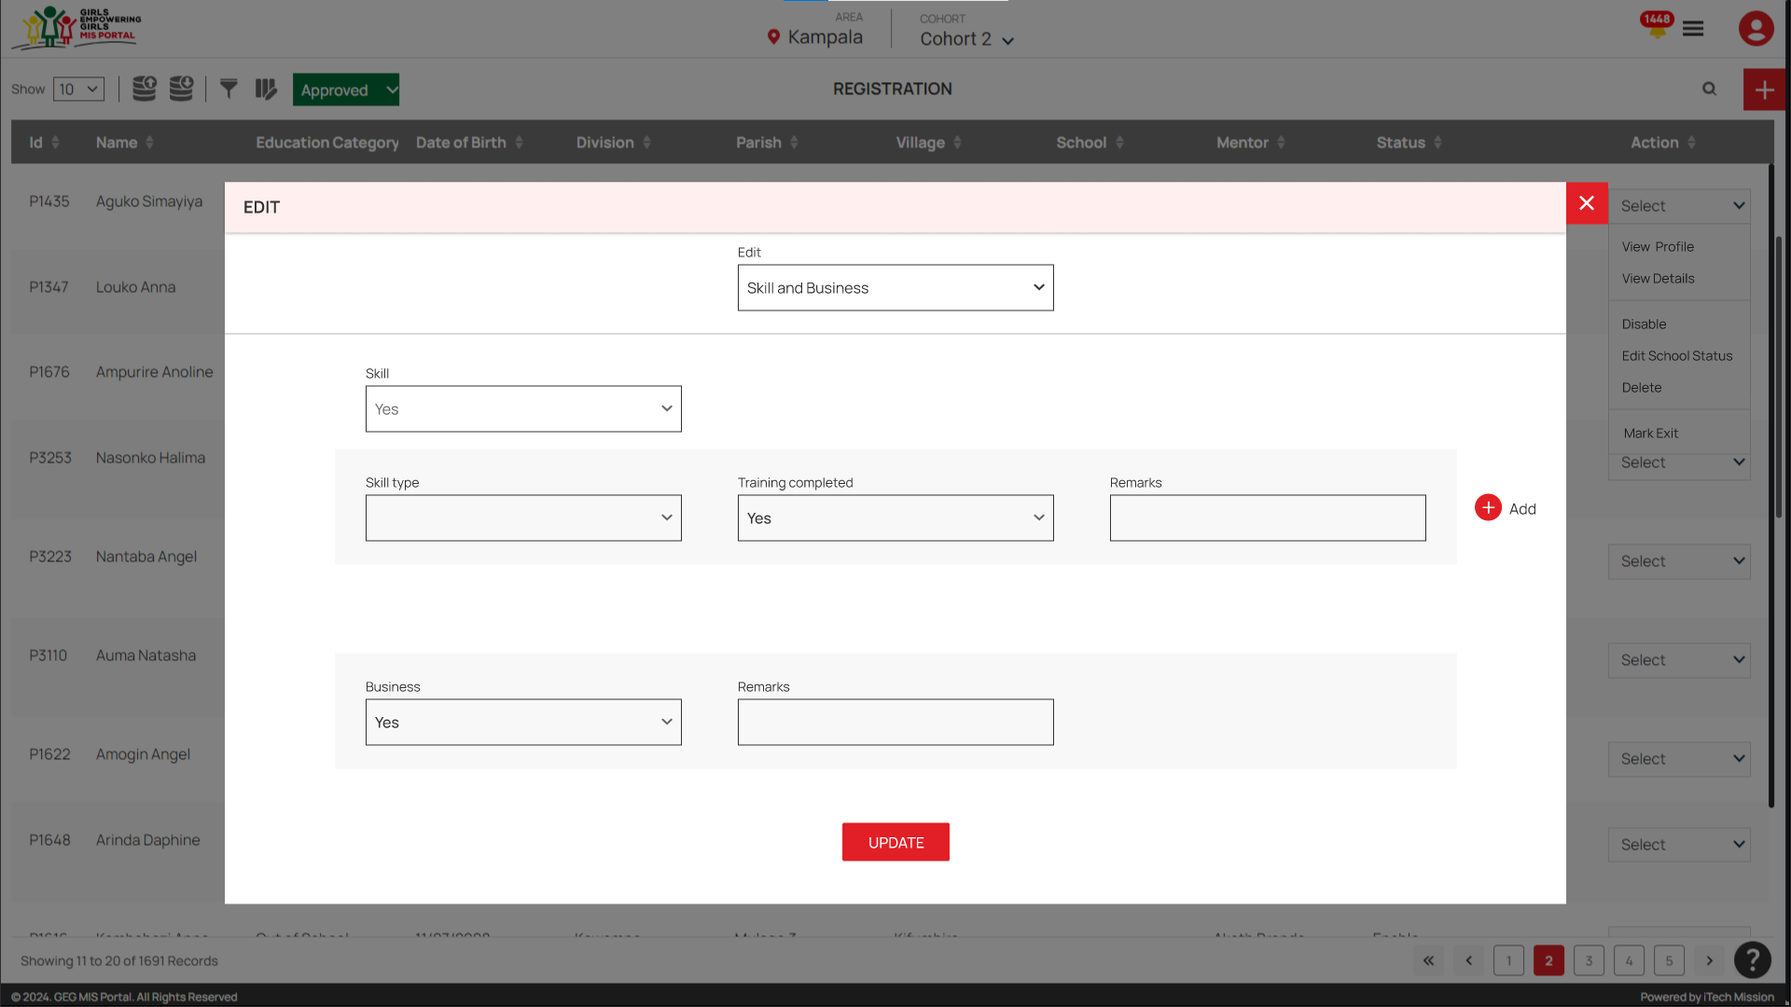
BR 2.5 Skill and business details

Slide 18
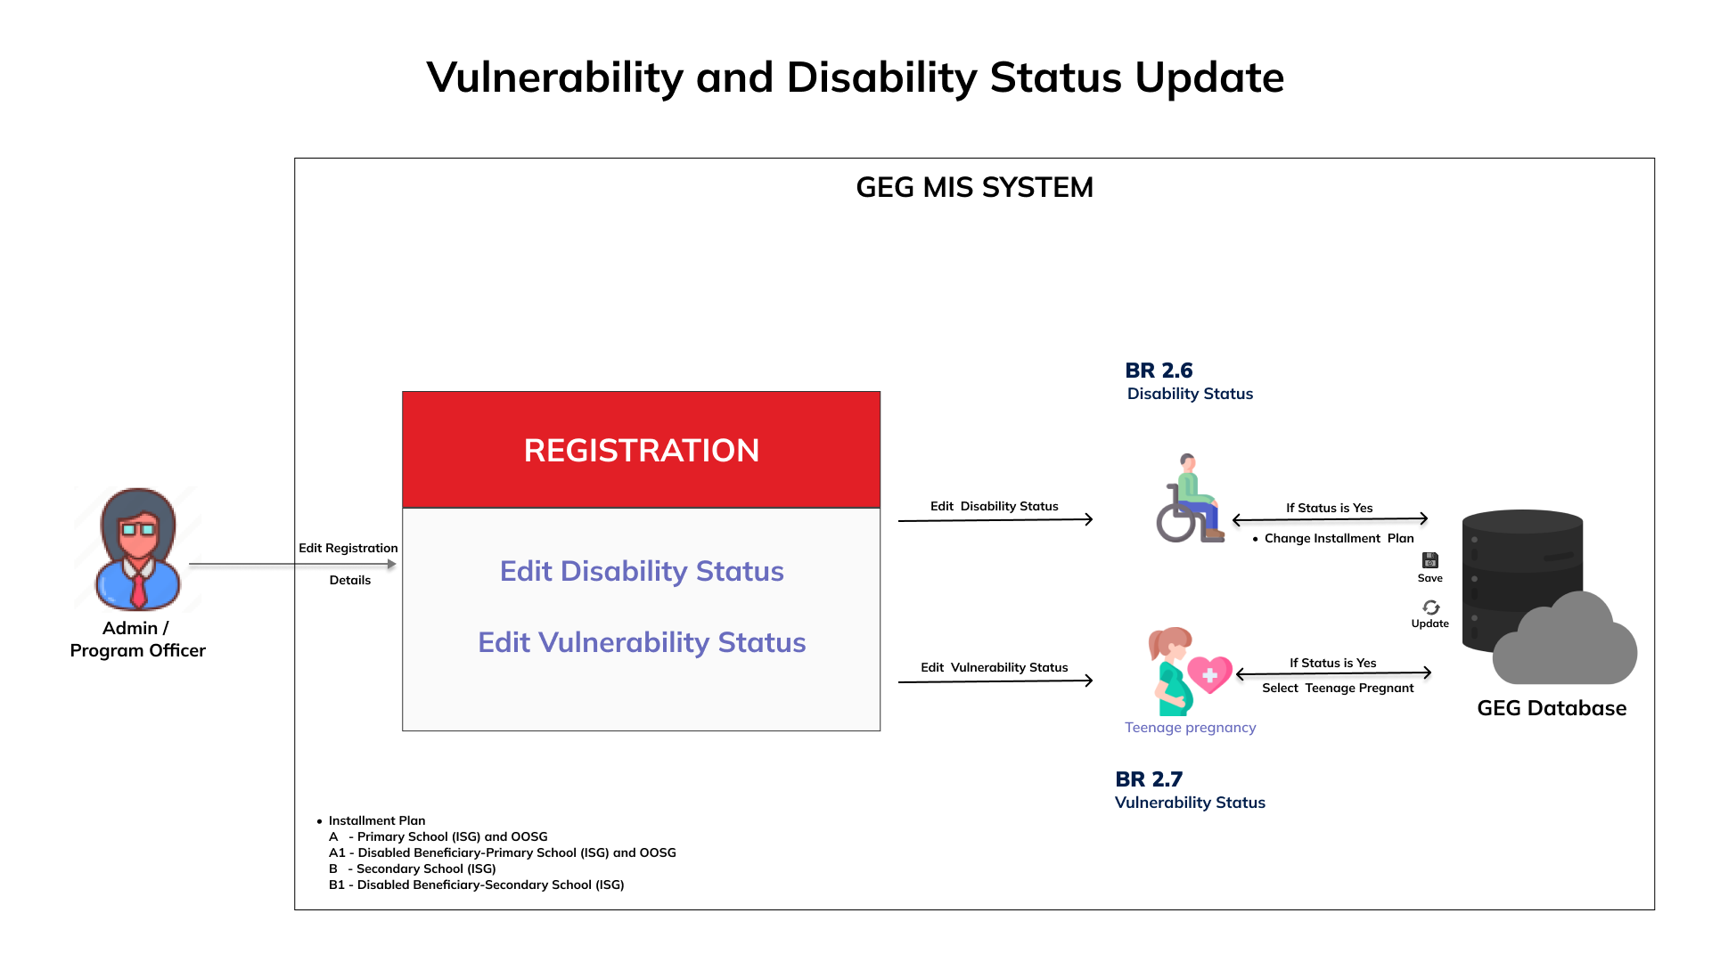
BR 2.6 Disability status

Slide 19

BR 2.6 Disability status

Slide 20
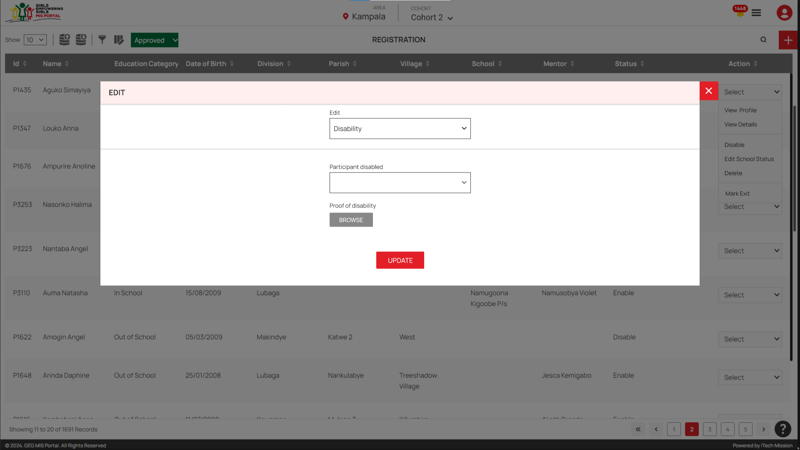
BR 2.6 Disability status

Slide 21
BR 2.7 Vulnerability status

Slide 22

BR 2.7 Vulnerability status

Slide 23
BR 2.7 Vulnerability status

Slide 24
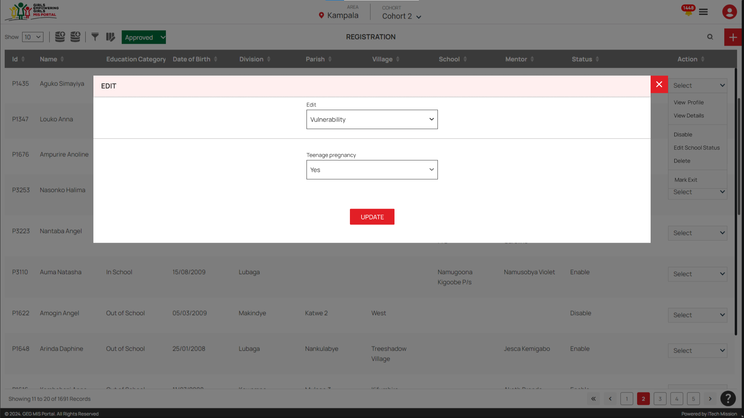
BR 2.7 Vulnerability status

Slide 25
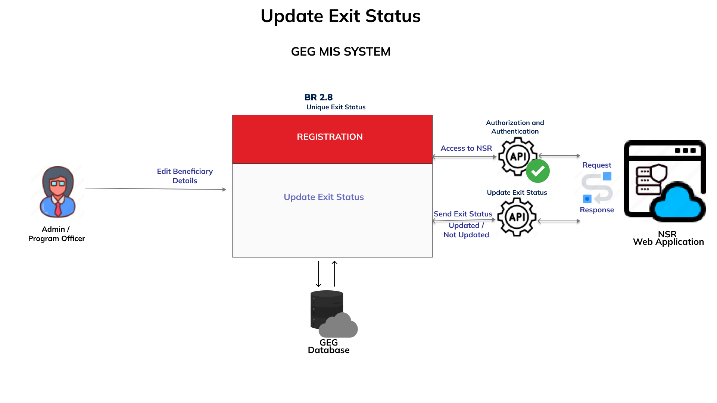
BR 2.8 Exit status

Slide 26
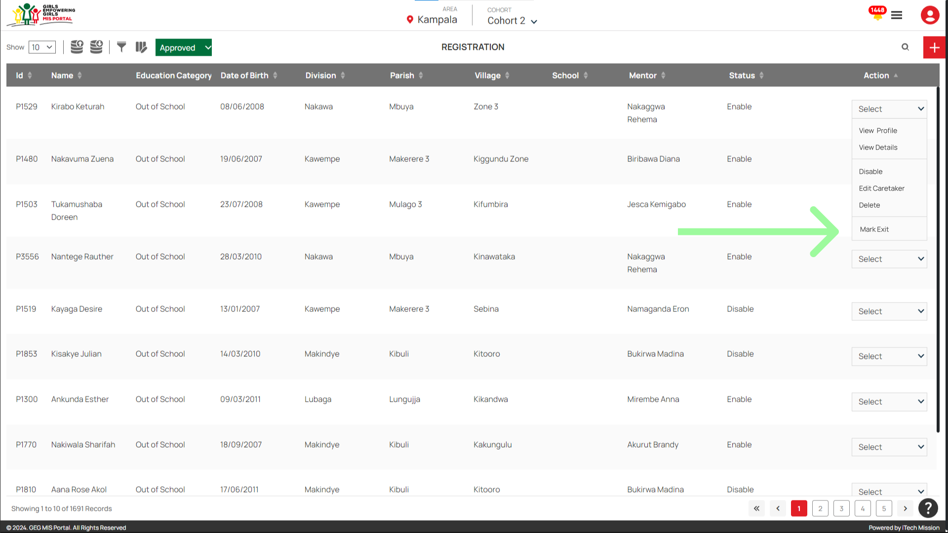
BR 2.8 Exit status

Slide 27
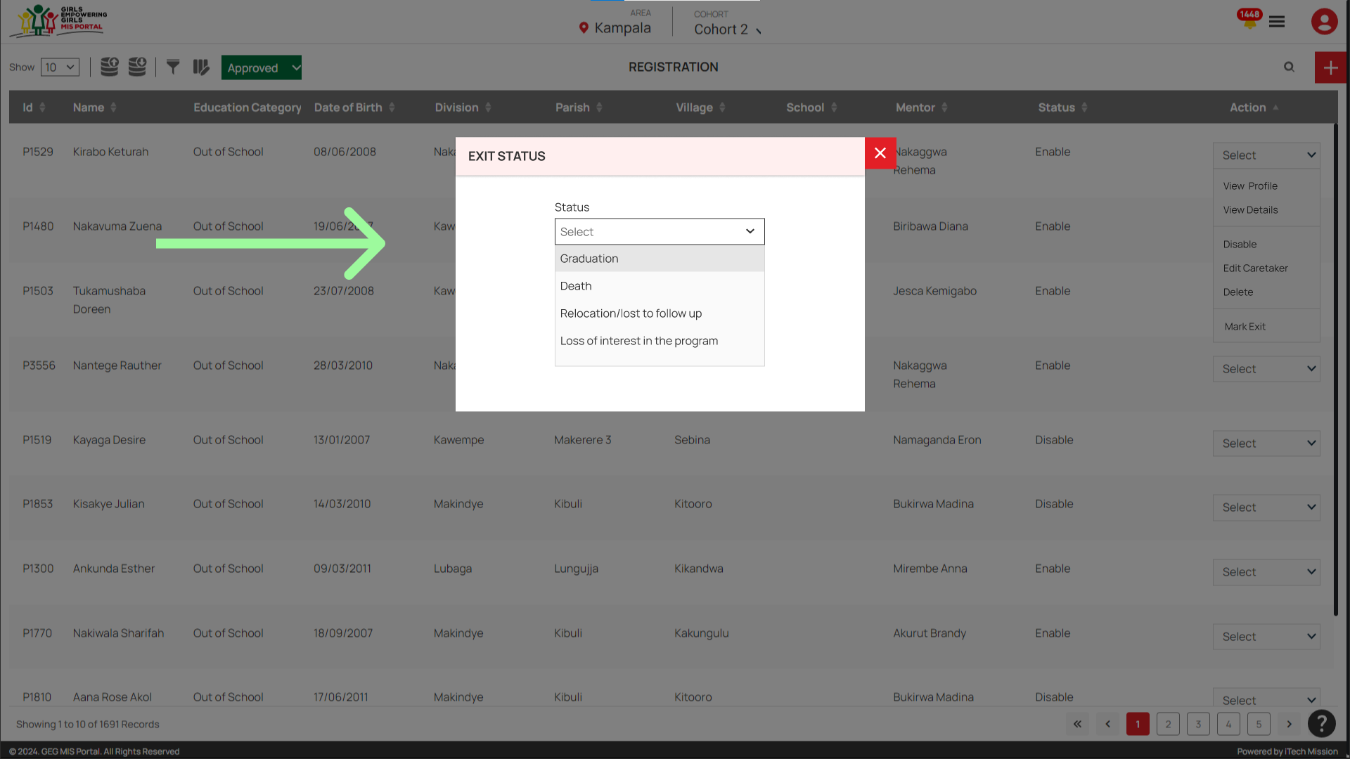
BR 2.8 Exit status

Slide 28
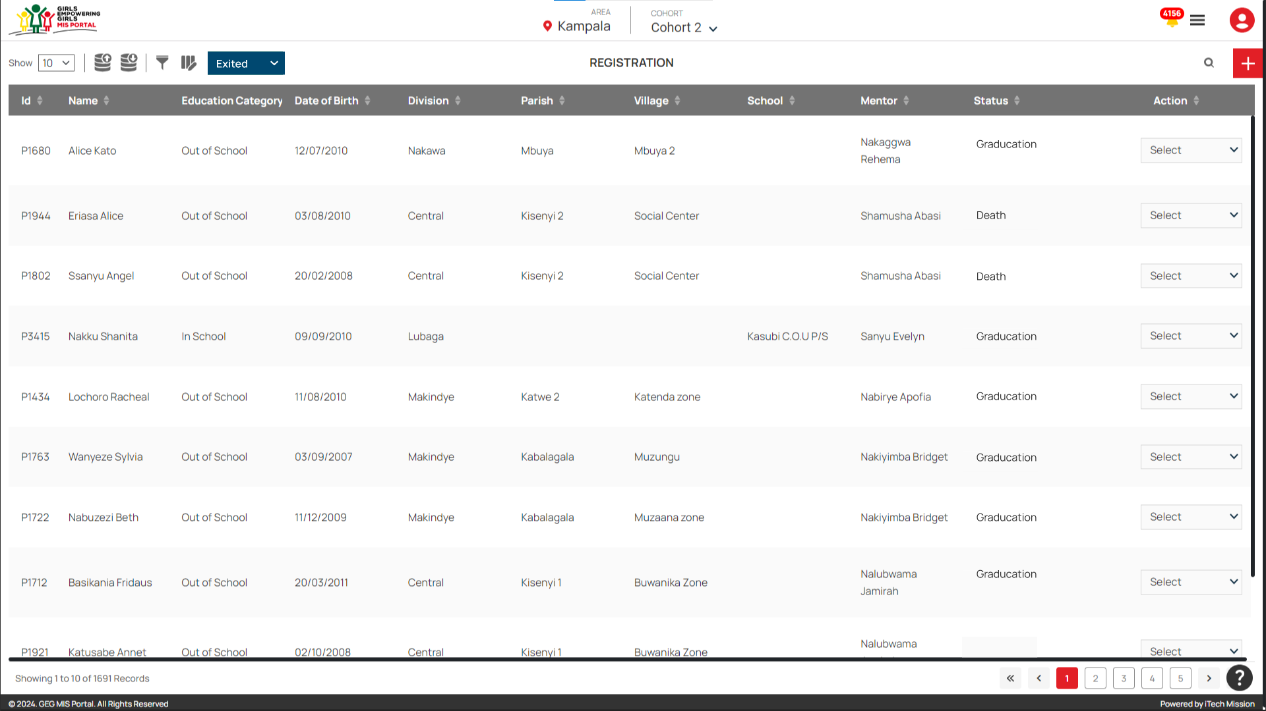
BR 2.8 Exit status

Slide 29
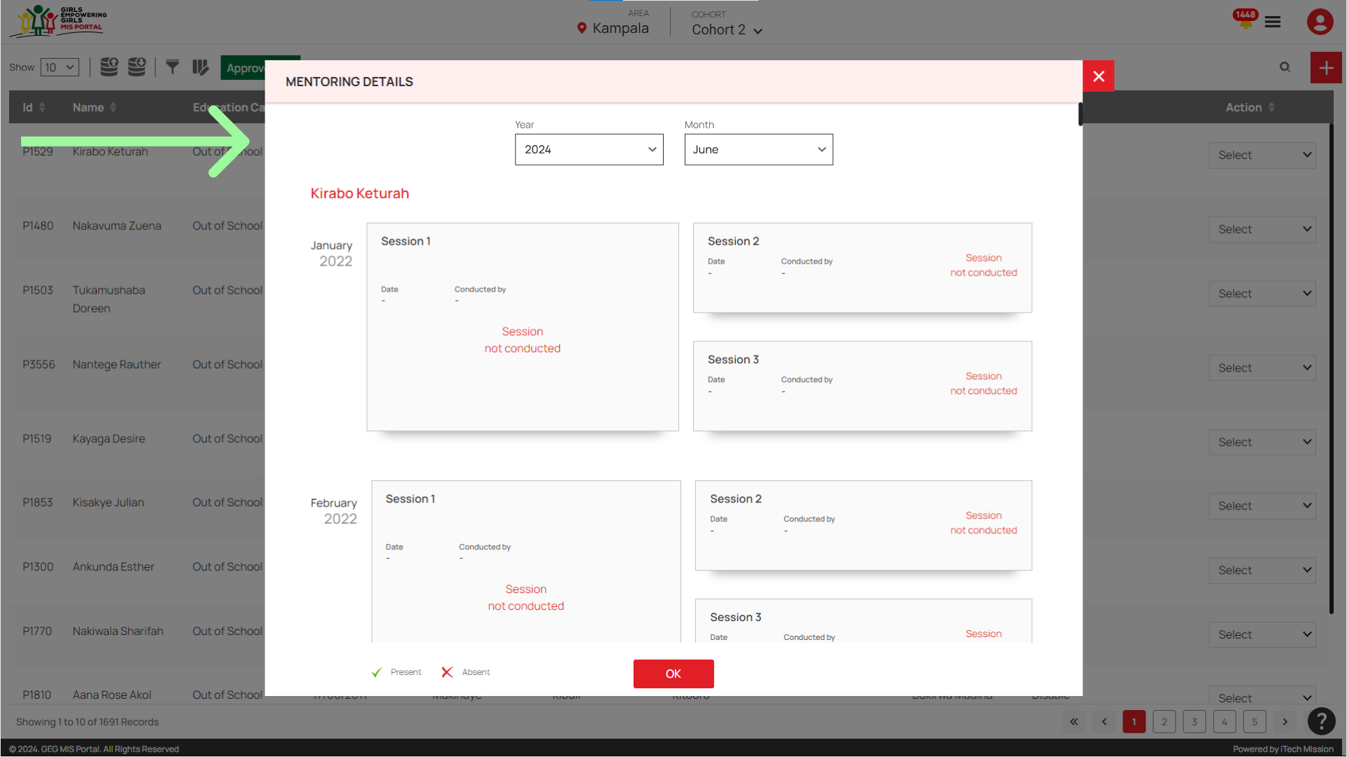
BR 3 Easy navigation in data entry

Slide 30
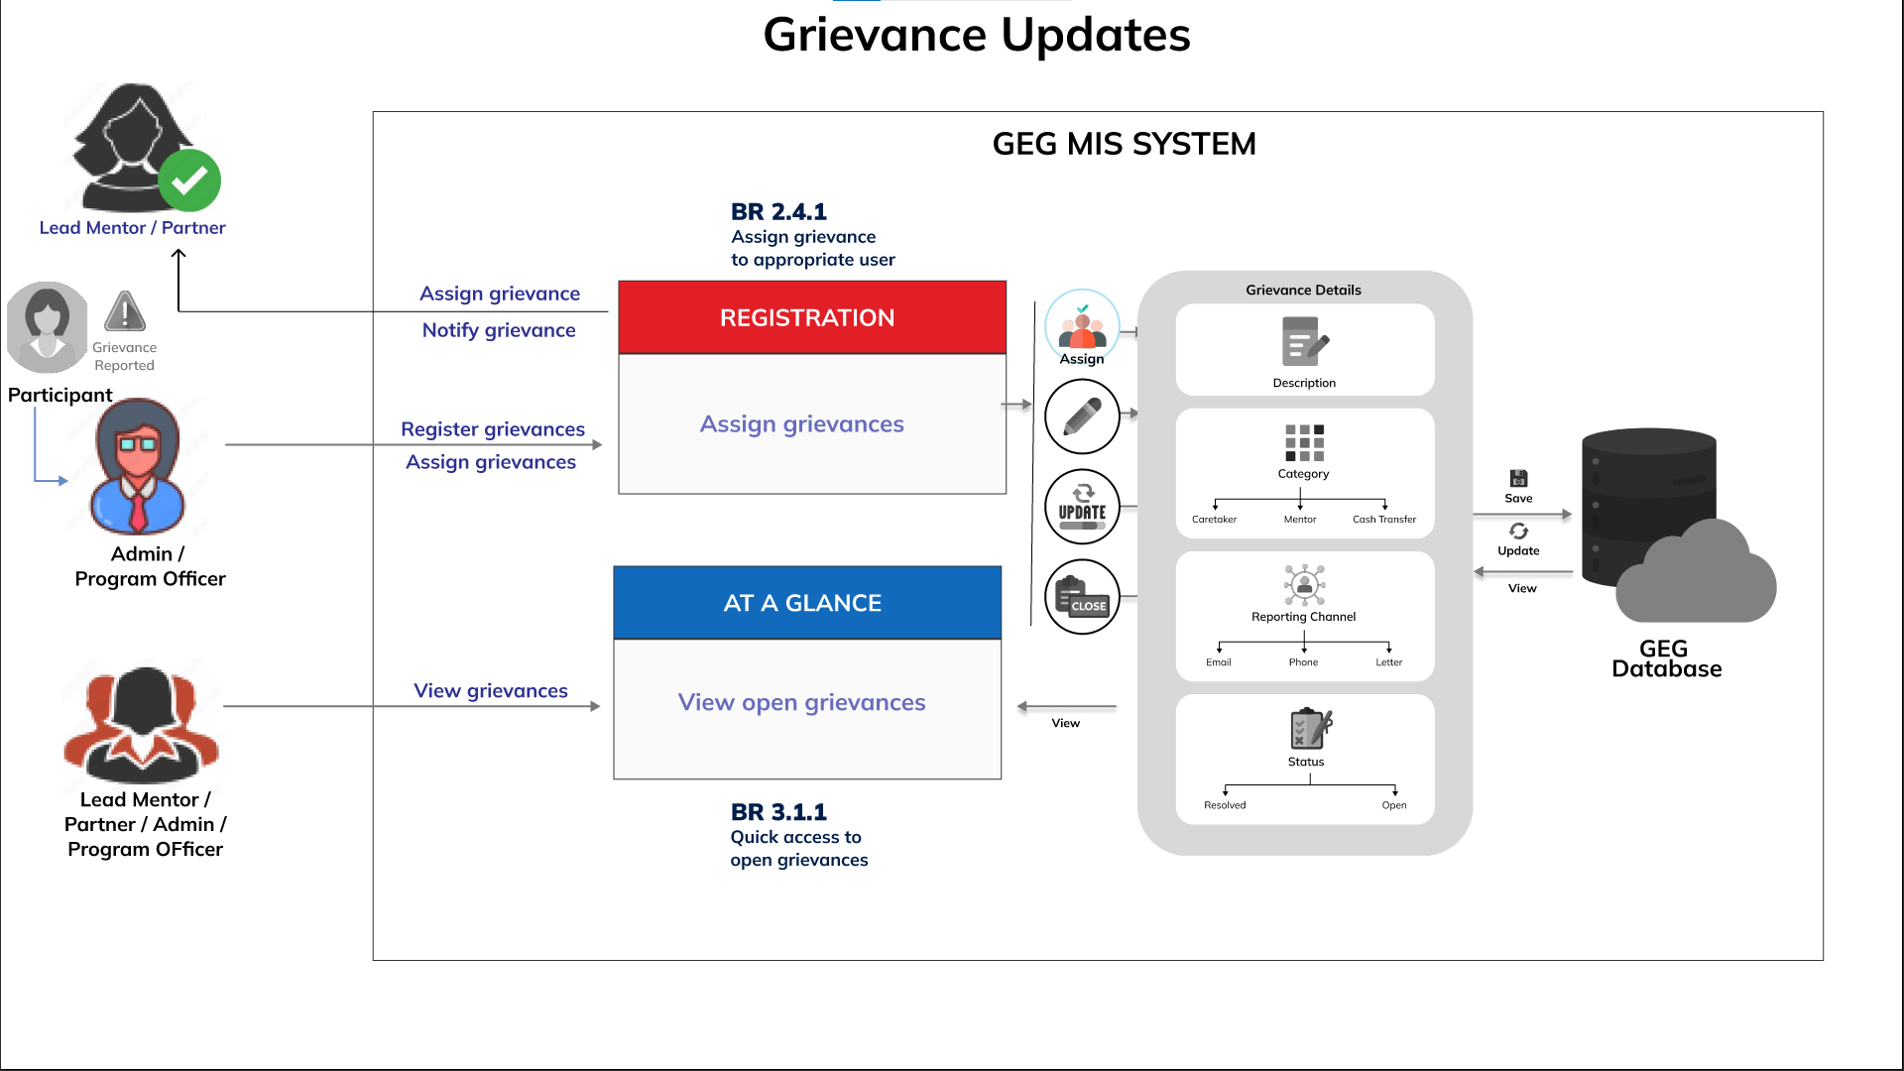
BR 4 Grievance

Slide 31
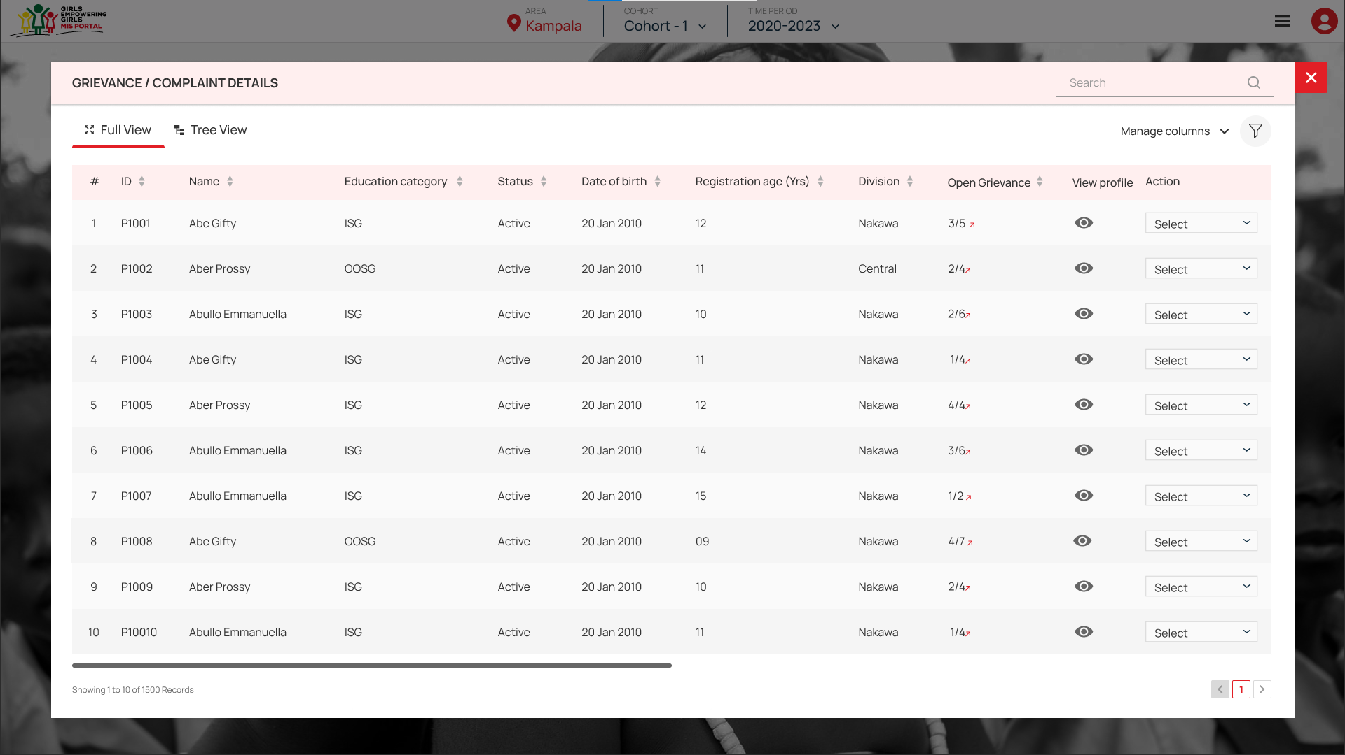
BR 4.1 Assign grievance to specific user

Slide 32
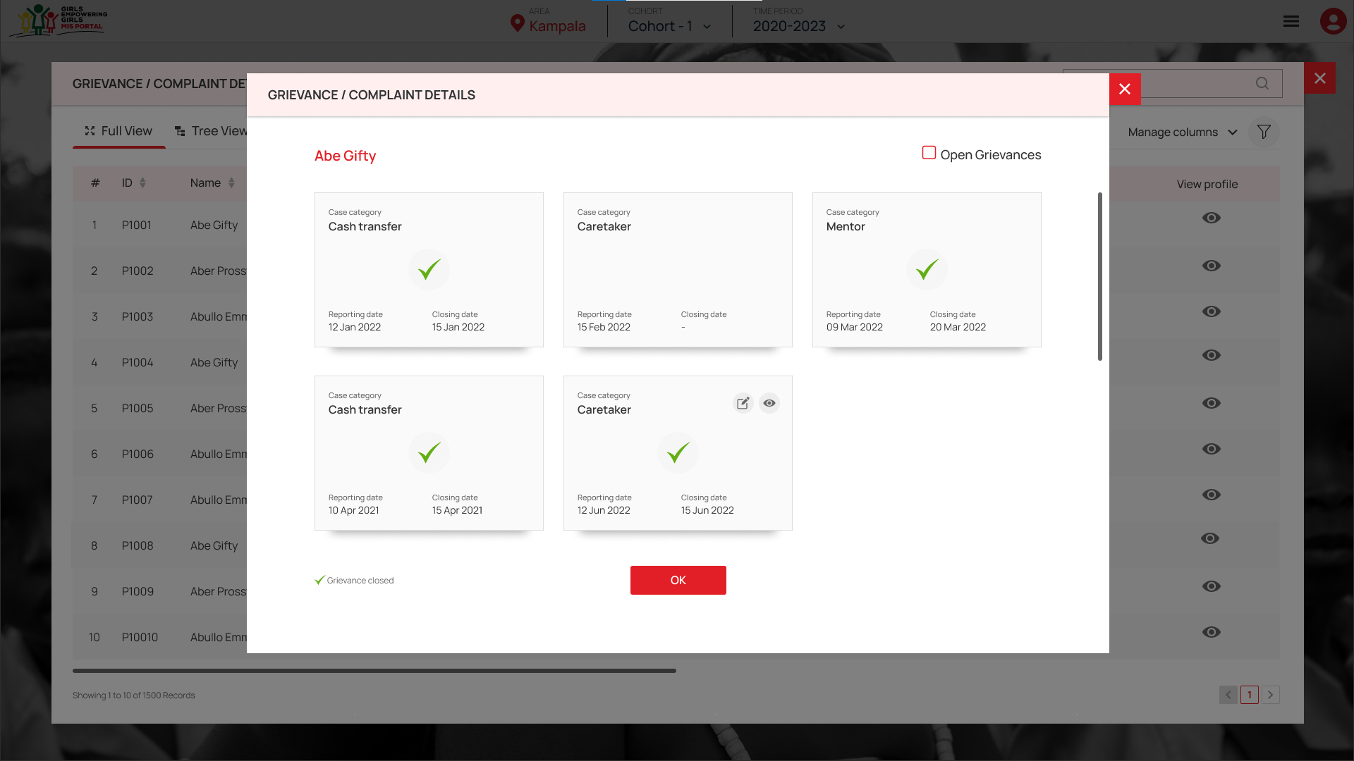
BR 4.1 Assign grievance to specific user

Slide 33
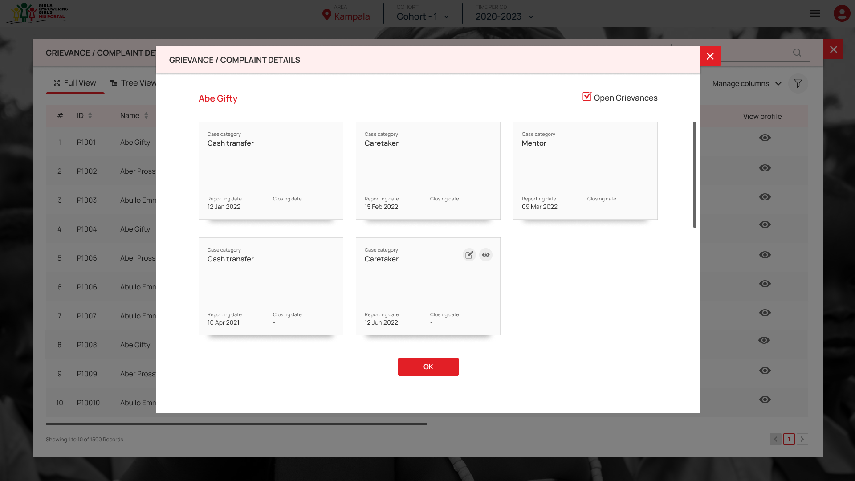
BR 4.1 Assign grievance to specific user

Slide 34
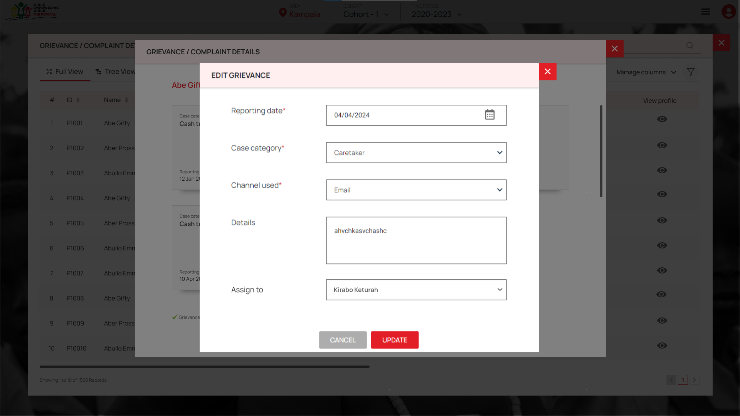
BR 4.1 Assign grievance to specific user

Slide 35
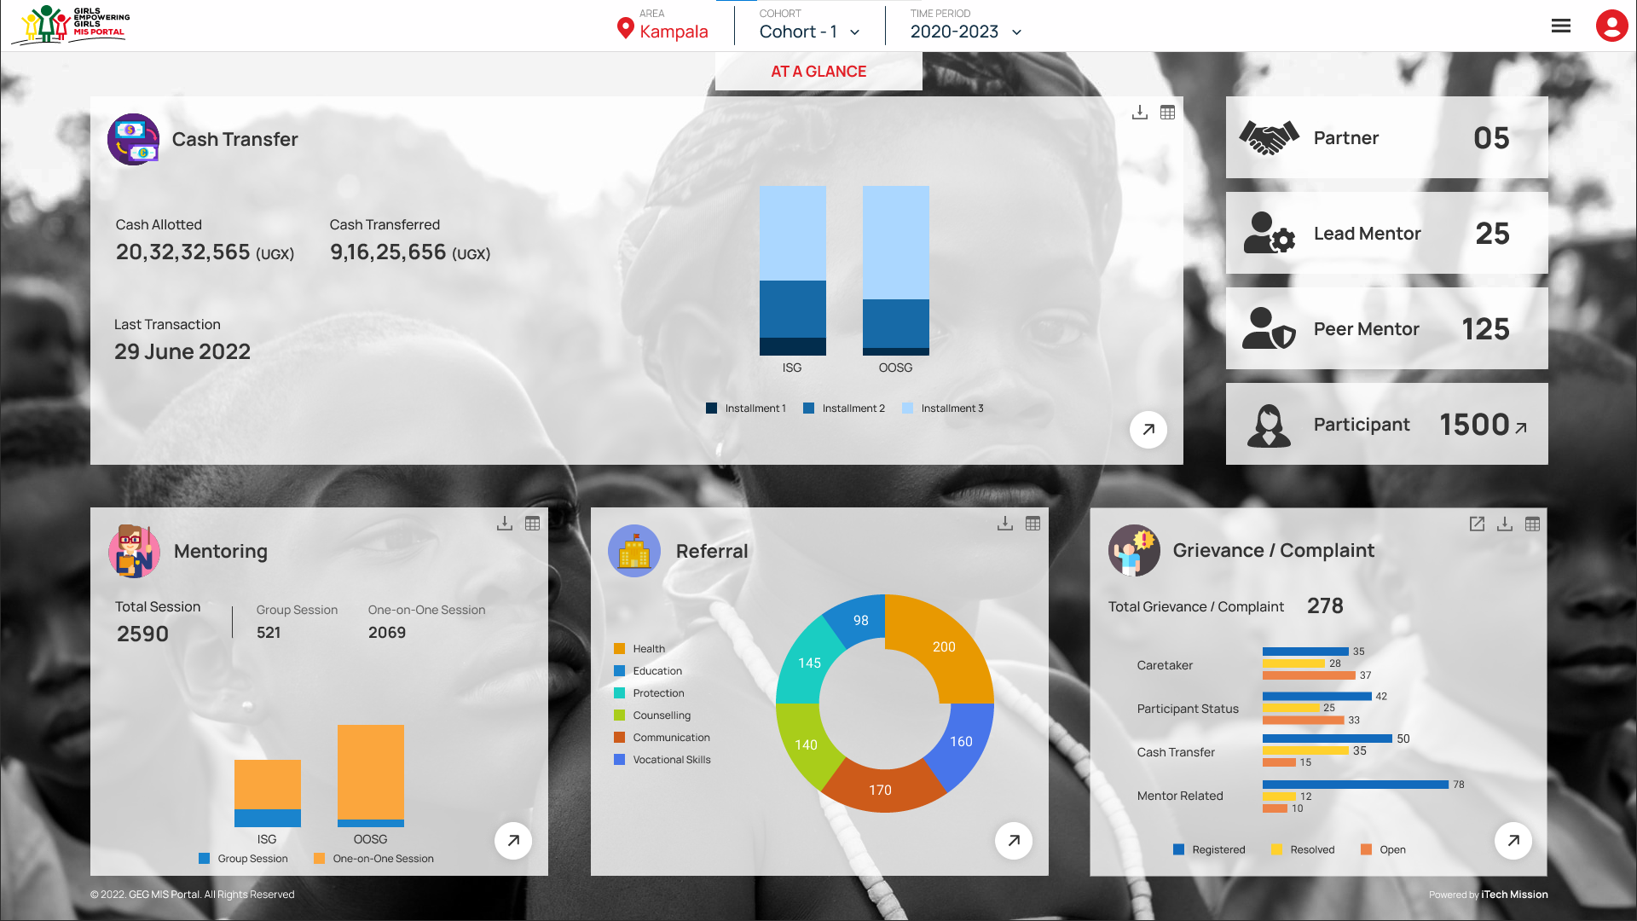
BR 4.2 Quick access to open grievance

Slide 36
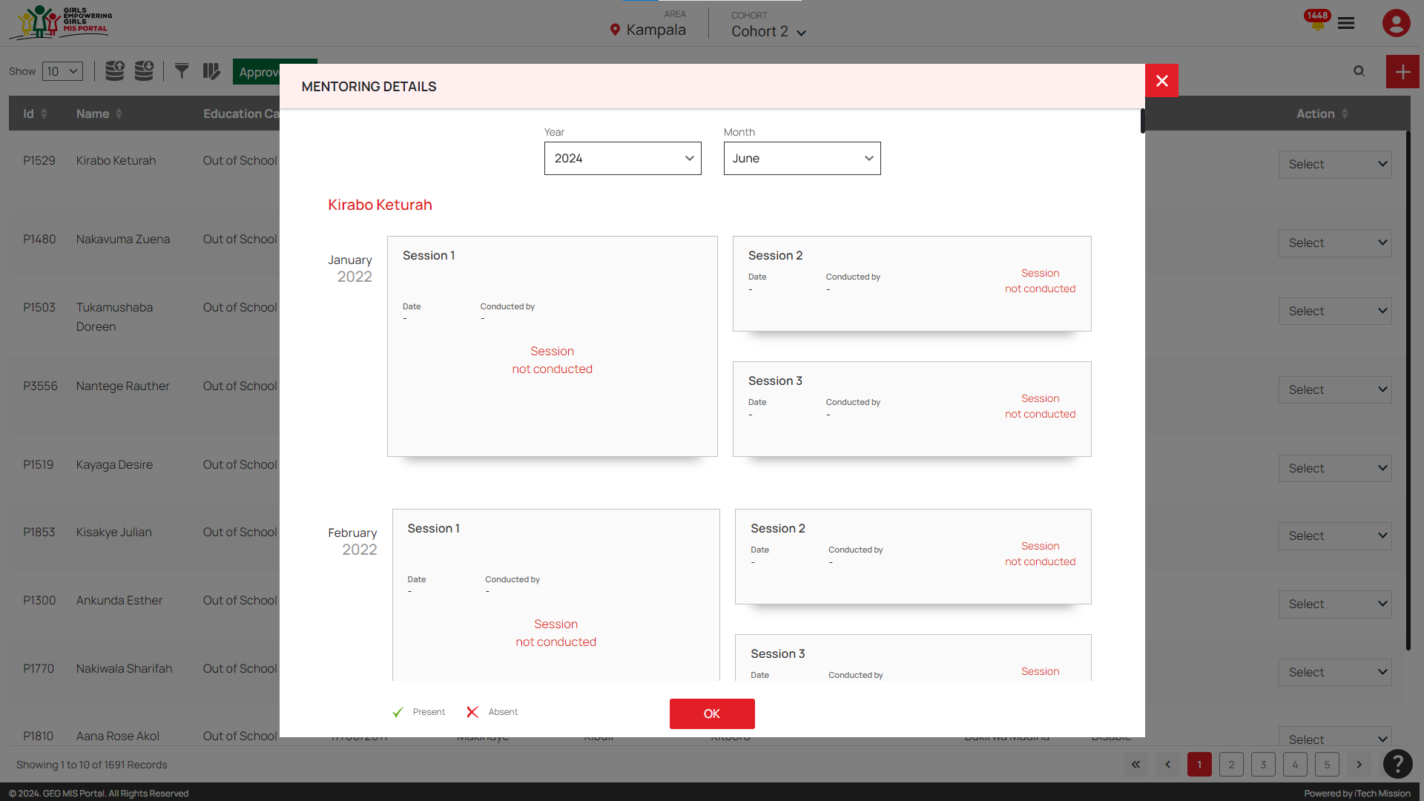
BR 5 Creation of email alerts

Slide 37
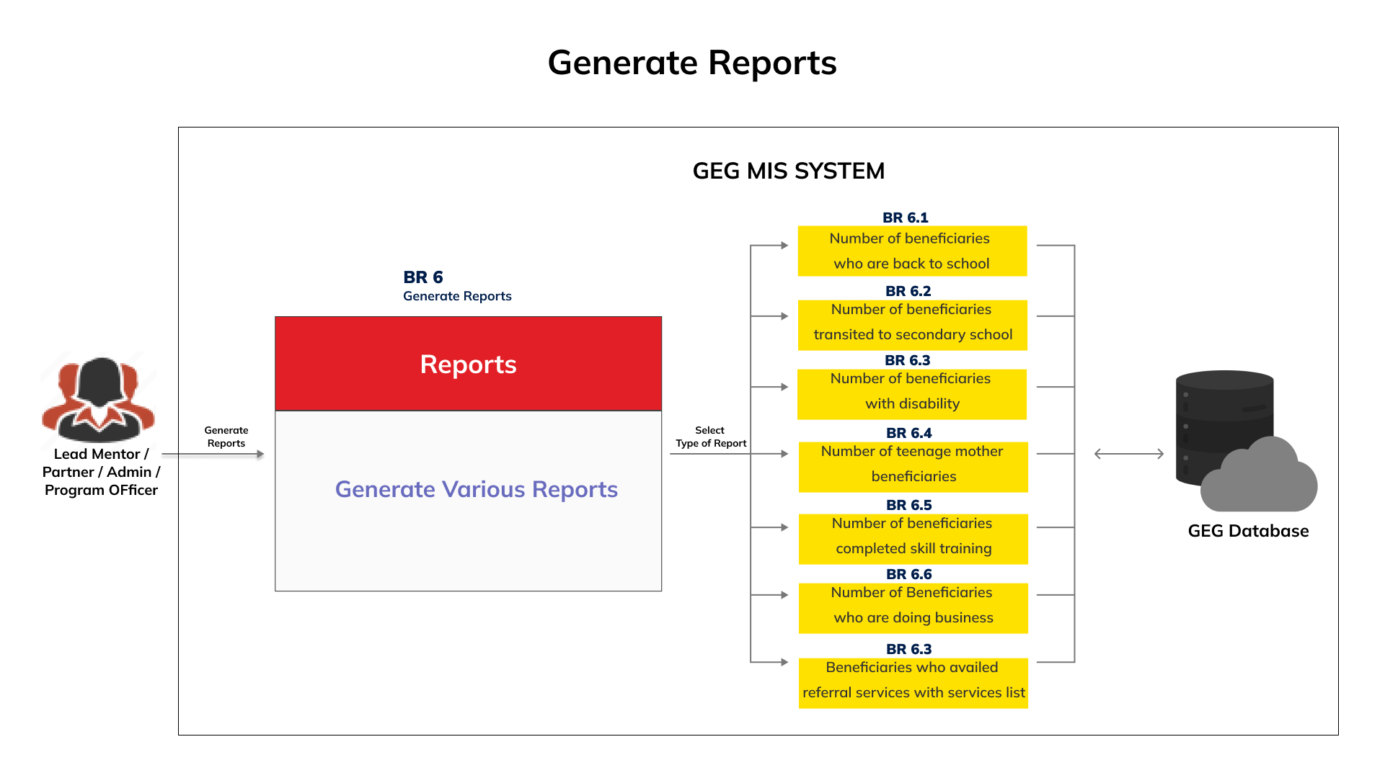
BR 6 Generation of reports and statistics

Slide 38
Requirement
Admin
Cohort
Cash transfer (Tagging of profiles to CT amounts)
The changes in the cash transfer amount to a beneficiary could be based on the “Transition to Secondary school” status other than originally discussed (year three for all ISG). We note that not all ISG transition in year 3 and that there are some OOSG who go back to school and transition to secondary school.
Identify the number of payment cycles of beneficiary

Slide 39
Requirement
Master Lists
OOSG undertaking skilling (Digital, Life skills, Foundational literacy and numeracy skills and I-Upshift, Bakery and cookery, Fashion and design, Leather designing, Electronics, Plumbing, Carpentry). Capture completion of training whether YES or NO and comment completion of training whether YES or NO and comment
OOSG doing business and to specify the kind of business by comment

Slide 40

